Slide 1
Evaluating the Implications & Impact of Charter School Expansion
Fall 2024

Slide 2
Overview
Disparities in student demographics between LPS and the charter school.
02
Impact of serving a diverse and increasingly multilingual student population.
03
Importance of considering district improvement efforts in the context of current challenges.
04
Alignment of KIPP with DESE's proven provider criteria
01

Slide 3
Alignment of KIPP with DESE's Proven Provider Criteria

Slide 4
Proven Provider Criteria Defined
4(b)1. The applicant shall submit data demonstrating success in student academic performance and evidence of academic program success, including but not limited to:
Proficiency levels and growth measures on the Massachusetts comprehensive assessment system or equivalent assessments for all students and for one or more targeted subgroups as defined in M.G.L. c. 71, § 89(i)(3), which are similar to statewide averages in English Language Arts and mathematics for all students in Massachusetts in comparable grades, over no less than a three-year period for cohorts of students;
Source: DESE

Slide 5
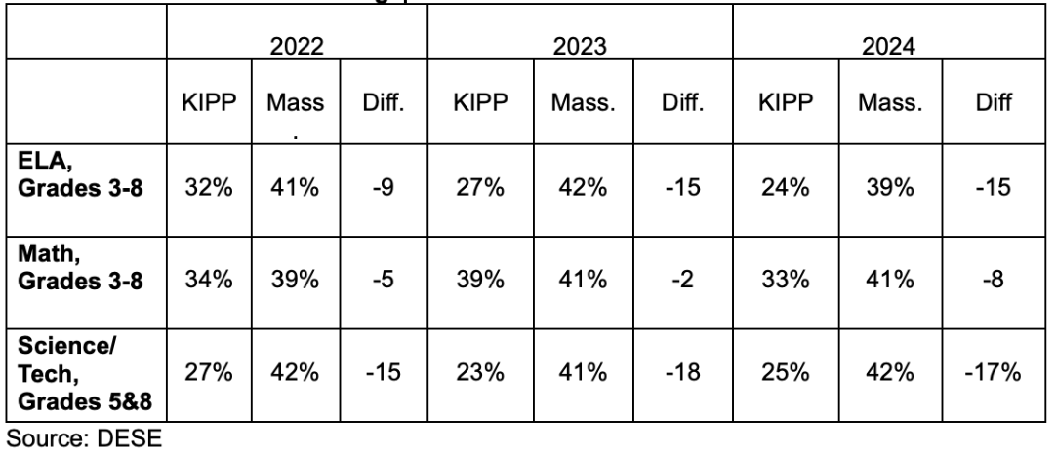
Percent of Students Meeting or Exceeding Expectations on MCAS KIPP Lynn vs. Massachusetts Statewide Average

Slide 6
Student Demographic Disparities: LPS vs. Charter Schools

Slide 7
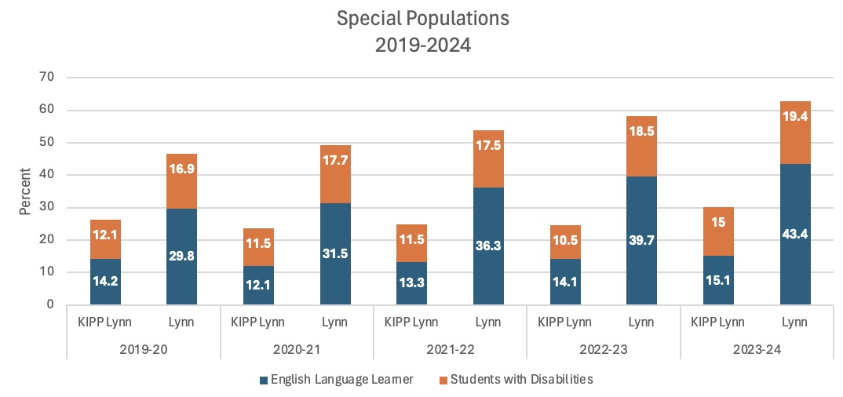
Demographic Disparities
Charter School Demographics:
Representation of students with diverse backgrounds, particularly multilingual learners (MLLs), newcomers, and students with high needs is starkly lower.
LPS Demographics:
Nearly 50% multilingual learners.
Unlike our neighboring charter schools, we provide services for homeless students, unaccompanied minors, and students requiring specialized disability services

Slide 8
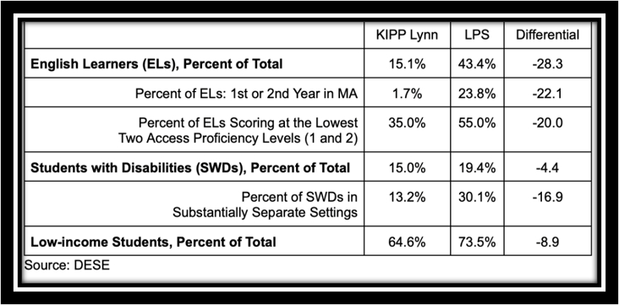
Demographic Disparities
LPS serves a significantly higher percentage of MLLs and newcomers, including students with various WIDA Access levels.
Charter school under-represents MLLs, especially those with lower English proficiency (WIDA Access, Levels 1-2).

Slide 9
Research: Annenberg Institute at Brown University Rising Numbers, Unmet Needs: Immigrant Newcomers in Massachusetts High Schools.
LPS serves the 2nd highest number of newcomers in Massachusetts.
Notes:
Although Boston has over 100 schools, the proportion of newcomers in LPS is significantly higher.

Slide 10
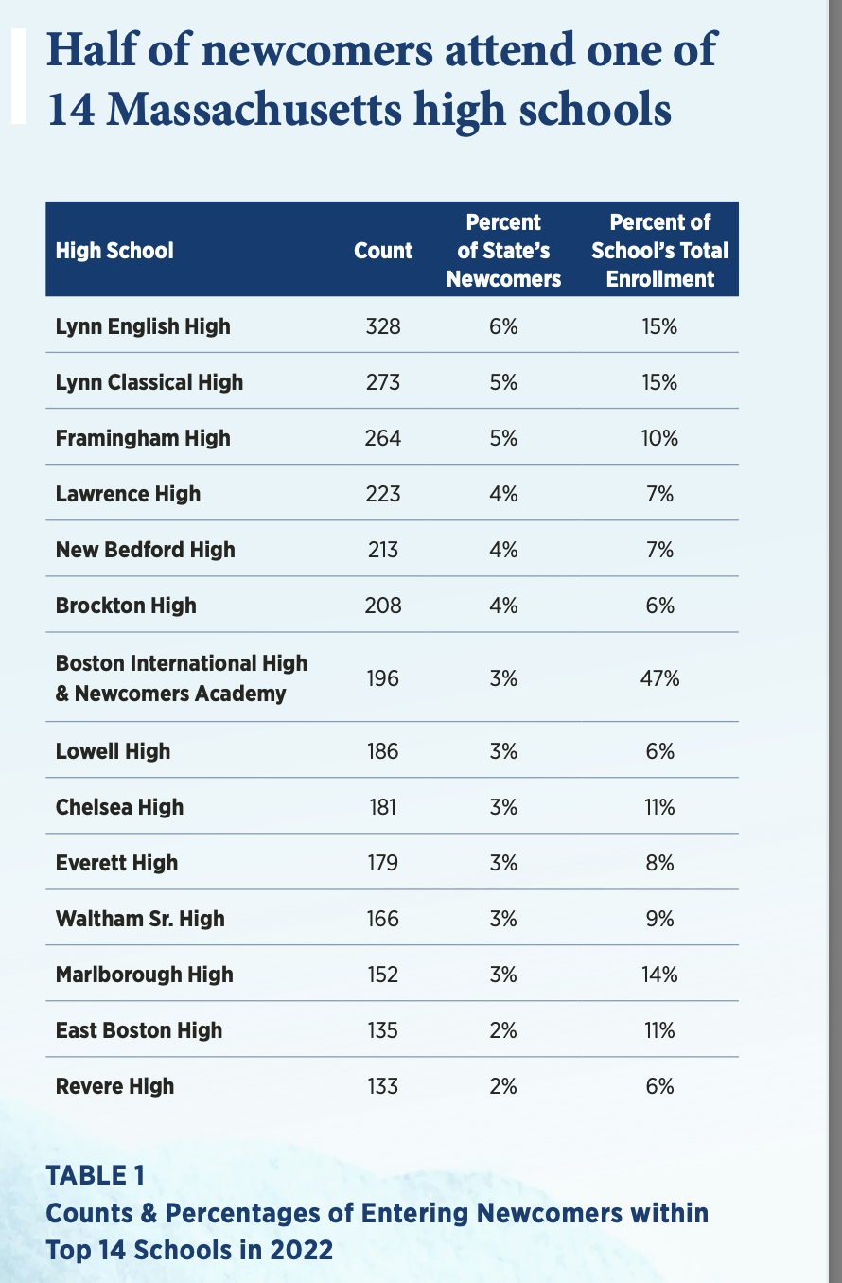
Impact of Serving All Students: Highest Enrollment of Newcomers in LPS
“Because of application timelines for charter schools, exam schools, and career/technical education (CTE) schools, newcomers face a limited set of high-school options in their districts, at least initially.”
- Annenberg Institute at Brown University

Slide 11
LPS Commitment to Serving High-Needs Students
Add Visual: Infographic showing types of services and programs offered by LPS for these populations.
Overview of LPS programs supporting homeless students, unaccompanied minors, SLIFE, and students with disabilities.
Impact: LPS provides comprehensive services that charter schools do not match, leading to unequal educational opportunities.

Slide 12
Charter School's Lack of Inclusivity
Multilingual Learners (MLLs) and Students with Disabilities:
Significant under-representation suggests potential barriers in the admissions process and/or lack of adequate support services.
Enrollment requirements or limited specialized programs may unintentionally exclude these students or make it difficult for families to navigate the process.
Unaccompanied Minors and Homeless Students:
Lack of tailored resources and support systems for these students may prevent them from enrolling or succeeding within the charter school.
Admission processes may not accommodate their unique living situations or educational histories.
Community-Wide Accessibility:
The school's existing structure and services may not be designed to fully meet the needs of all students in the Lynn community, creating inequities in educational access.
Notes:
Potential Barriers to Admission and Enrollment for Vulnerable Populations

Slide 13
District Improvement Efforts

Slide 14
LPS Improvement
Reduced the number of schools requiring assistance or needing intervention in one year from 14 to 11
Maintained and/or increased SGP for Literacy and Math for the past four years
Expanded supports for multilingual learners
Enhanced services for high needs students
Growth in newcomer integration

Slide 15
Why Expansion is Not the Solution
Failure to Meet Proven Provider Criteria
Not meeting these standards, it suggests a lack of demonstrated effectiveness or sufficient outcomes to justify expansion. Without evidence-based performance, expanding these schools could risk diverting resources from public schools without ensuring better outcomes for students.
Lack of Support for High-Need Populations
Lack of robust services for groups like homeless students, unaccompanied minors, and students requiring specialized disability services. LPS, on the other hand, has established programs to address these needs. Expanding charter schools without equivalent support mechanisms risks leaving these vulnerable populations underserved.
Impact of Application Timelines on Newcomers
Application processes are often rigid and can disadvantage newcomers—students who arrive mid-year or later. These students may face significant barriers to enrollment in charter schools, leaving local public schools to shoulder the responsibility for providing education and support.
Potential for Resource Diversion
Undermines public schools' ability to continue offering comprehensive services to all students, especially high-needs populations.
EQUITY CONCERNS
Notes:
Public schools often serve as community hubs for all students, regardless of background or need. If charter schools underrepresent MLLs and other vulnerable groups, their expansion risks deepening existing inequities rather than addressing them. Public schools like LPS, which are inclusive of all students, may be better positioned to address the holistic needs of the community.
In summary, charter school expansion may not align with the priorities of equity and inclusivity for MLLs, newcomers, and high-needs students. Instead, focusing on strengthening existing public schools like LPS, might be a more sustainable and equitable solution.

Slide 16
Call to Action: Support LPS in Serving All Students
Strengthen Newcomer Programs and Accessibility
Expand Access to Specialized Support Services
Support Targeted Resources for Multilingual Learners
Hold Charter Schools Accountable

Slide 17
Thank You & Questions

